Slide 1
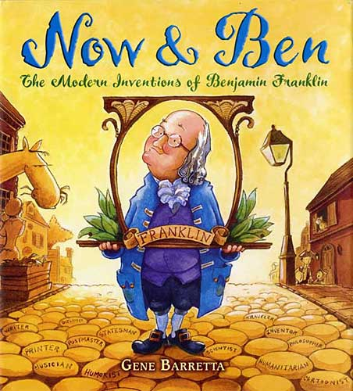
Vocabulary Review for

Slide 2
I enjoy spending large _____ of time at the beach.
a) inventions
b) remarkable
c) designed
d) amounts
e) result
f) achieve
g) composed
h) accomplishments

Slide 3
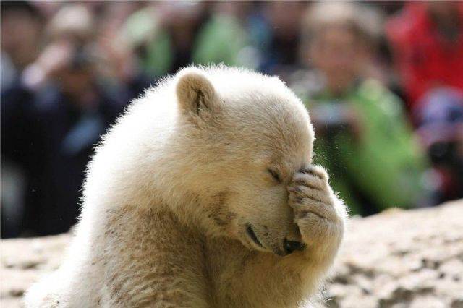
OOPS!! Try Again

Slide 4
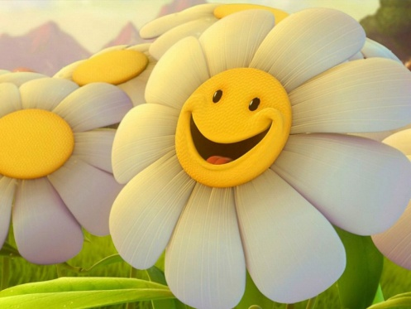
GOOD JOB!!

Slide 5
I sat down with me dad and we ______ a song.
a) inventions
b) remarkable
c) designed
d) amounts
e) result
f) achieve
g) composed
h) accomplishments

Slide 6
GOOD JOB!!

Slide 7
My baseball team had a very ______ winning record.
a) inventions
b) remarkable
c) designed
d) amounts
e) result
f) achieve
g) composed
h) accomplishments

Slide 8
GOOD JOB!!

Slide 9
Our football team made many ______ this season.
a) inventions
b) remarkable
c) designed
d) amounts
e) result
f) achieve
g) composed
h) accomplishments

Slide 10
GOOD JOB!!

Slide 11
My friends and I enjoy trying to create new _______.
a) inventions
b) remarkable
c) designed
d) amounts
e) result
f) achieve
g) composed
h) accomplishments

Slide 12
GOOD JOB!!

Slide 13
When a basketball player makes a basket, the _____ is two points.
a) inventions
b) remarkable
c) designed
d) amounts
e) result
f) achieve
g) composed
h) accomplishments

Slide 14
GOOD JOB!!

Slide 15
The boy worked hard to _____ good grades on his report card.
a) inventions
b) remarkable
c) designed
d) amounts
e) result
f) achieve
g) composed
h) accomplishments

Slide 16
GOOD JOB!!

Slide 17
In art class the students _____ their own playground.
a) inventions
b) remarkable
c) designed
d) amounts
e) result
f) achieve
g) composed
h) accomplishments

Slide 18
GOOD JOB!!

Slide 19
Which word goes with wrote and created?
a) inventions
b) remarkable
c) designed
d) amounts
e) result
f) achieve
g) composed
h) accomplishments

Slide 20
GOOD JOB!!

Slide 21
Which word goes with answer, effect and outcome?
a) inventions
b) remarkable
c) designed
d) amounts
e) result
f) achieve
g) composed
h) accomplishments

Slide 22
GOOD JOB!!

Slide 23
Which word goes with amazing and surprising?
a) inventions
b) remarkable
c) designed
d) amounts
e) result
f) achieve
g) composed
h) accomplishments

Slide 24
GOOD JOB!!

Slide 25
When I set a goal I hope to do this to it. What word am I?
a) inventions
b) remarkable
c) designed
d) amounts
e) result
f) achieve
g) composed
h) accomplishments

Slide 26
GOOD JOB!!

Slide 27
To create these, you need creativity, imagination and new ideas. What word am I?
a) inventions
b) remarkable
c) designed
d) amounts
e) result
f) achieve
g) composed
h) accomplishments

Slide 28
GOOD JOB!!

Slide 29
Which word goes with numbers and total?
a) inventions
b) remarkable
c) designed
d) amounts
e) result
f) achieve
g) composed
h) accomplishments

Slide 30
GOOD JOB!!

Slide 31
My mom and I did this to my birthday cake. What word am I?
a) inventions
b) remarkable
c) designed
d) amounts
e) result
f) achieve
g) composed
h) accomplishments

Slide 32
GOOD JOB!!

Slide 33
The police officer had lots of these, so he received an award. What word am I?
a) inventions
b) remarkable
c) designed
d) amounts
e) result
f) achieve
g) composed
h) accomplishments

Slide 34
GOOD JOB!!

Slide 35
Nice Work!!
You have
mastered your Vocabulary Words!

